Slide 1


K.RAMAKRISHNAN COLLEGE OF TECHNOLOGY (AUTONOMOUS), TRICHY
TO-DO APPLICATION
PRESENTED BY
2303811710621114- THARUN KUMAR. M
Guided by
Mrs. KARPOORA SUNDARI.M.E.,

Slide 2
PRESENTATION OVERVIEW
PROJECT INTRODUCTION
PROJECT OBJECTIVE
PROBLEM STATEMENT
LIBRARIES USED
EXISTING SYSTEM
PROPOSED SYSTEM
BLOCK DIAGRAM
MODULE DESCRIPTION
CONCLUSION AND FUTURE ENHANCEMENT

Slide 3
PROJECT INTRODUCTION
The project, “TO-DO APPLICATION ,"allows users to manage their tasks effectively by adding, deleting, editing, marking tasks as completed, setting due dates, and displaying all tasks.
The application is designed to help users keep track of their daily activities and ensure that they complete their tasks on time.

Slide 4
PROJECT OBJECTIVE
To create a user-friendly command-line to-do list application that helps users manage their tasks efficiently. To provide functionalities for add new tasks, delete tasks, edit task descriptions, mark tasks as completed, set due dates for tasks, and display all tasks.

Slide 5
PROBLEM STATEMENT
Managing tasks can often be challenging, especially when there are multiple tasks with varying priorities and deadlines. Many individuals struggle to keep track of their tasks, leading to missed deadlines and incomplete work. A simple and efficient to-do list application can help users organize their tasks, set priorities, and ensure timely completion of their activities.

Slide 6
LIBRARIES USED
The project uses the following Python library:
datetime:
This library is used to handle date and time operations, specifically for setting and formatting due dates for tasks.

Slide 7
EXISTING SYSTEM
Existing to-do list applications range from simple paper-based lists to complex software solutions with numerous features. However, many users find existing software too complex or feature-rich for their basic needs. There is a need for a simple, command-line based to-do list application that focuses on core functionalities without unnecessary complexity.

Slide 8
DISADVANTAGES OF EXISTING SYSTEM
Resource Intensive: Some existing applications consume significant system resources, which can slow down performance, especially on older or less powerful devices.
Learning Curve: Advanced features and interfaces in existing applications can have a steep learning curve, making them less accessible to users who prefer simplicity.
Potential Cost: Some existing task management solutions come with a cost, either as a one-time purchase or a subscription, which can be a barrier for some users.
Overly Complex for Basic Needs: Many existing task management applications are feature-rich and complex, which can be overwhelming for users who only need basic task management functionality.
Dependency on Cloud Services: Many existing systems rely on cloud services for storage and synchronization, which can raise concerns about data privacy and security.

Slide 9
PROPOSED SYSTEM
The proposed system is a command-line to-do list application written in Python. It offers the following functionalities:
Add new tasks with optional due dates.
Delete existing tasks by index.
Edit the descriptions of existing tasks.
Mark tasks as completed.
Set due dates for tasks.
Display all tasks with their statuses and due dates.
This system aims to be user-friendly and straightforward, catering to users who need an efficient way to manage their tasks without the overhead of complex software.

Slide 10
ADVANTAGES OF PROPOSED SYSTEM
Simplicity and Ease of Use
Focus on Core Features
Quick Setup and Execution
Customizable and Extensible
Low Resource Consumption

Slide 11
BLOCK DIAGRAM
Creates a new TodoItem and adds it to the list of tasks in the TodoApp.
Deletes the task at the specified index from the list of tasks in the TodoApp.
.
Add task Module
Delete task Module
Edit task Module
Set task due date
Mark as completed task
Exit
Updates the task description at the specified index in the TodoApp.
Select choices
Marks the task at the specified index as completed in the TodoApp.
Exit the application
Sets or updates the due date for the task at the specified index in the TodoApp.

Slide 12
Module Description
Add task Module
Delete task Module
Edit task Module
Set task due date
Mark as completed task
Exit

Slide 13
Add task Module
Add TaskChoice:
Add a new task to the to-do list.
Input Task Description:
Prompts the user to enter a description of the new task.
Input Due Date (Optional):
Prompts the user to enter an optional due date for the task.
Add to List:
Creates a new TodoItem and adds it to the list of tasks in the TodoApp.

Slide 14
Delete task
Delete TaskChoice: Remove a task from the to-do list.
Functionality: Prompts the user to enter the index of the task to be deleted.
Remove from List: Deletes the task at the specified index from the list of tasks in the TodoApp..

Slide 15
Edit task
Edit the description of an existing task.
Functionality:. Prompts the user to enter the index of the task to be edited.
Input New Description: Prompts the user to enter the new description for the task.
Update Description: Updates the task description at the specified index in the TodoApp.

Slide 16
Mark task as completed
Functionality: Prompts the user to enter the index of the task to be marked as completed.
Set Completed Status: Marks the task at the specified index as completed in the TodoApp..

Slide 17
Set task due date
Set Due DateChoice: Set or update the due date for an existing task.
Functionality: Prompts the user to enter the index of the task for which to set the due date.
Input Due Date: Prompts the user to enter the new due date for the task in the format "YYYY-MM-DD".Update Due Date: Sets or updates the due date for the task at the specified index in the TodoApp

Slide 18
CONCLUSION AND FUTURE ENHANCEMENT
The command-line to-do list application provides a simple yet effective way to manage tasks. It helps users keep track of their activities, set due dates, and ensure tasks are completed on time. The application is easy to use and fulfills the basic needs of task management.
Future enhancements could include:
Persistent Storage: Save tasks to a file or database to retain them between sessions.
Priority Levels: Add functionality to set and sort tasks by priority.
Recurring Tasks: Support for tasks that repeat on a regular basis.
User Interface: Develop a graphical user interface for more user-friendlyexperience.
Notifications: Implement reminders or notifications for upcoming due dates.

Slide 19
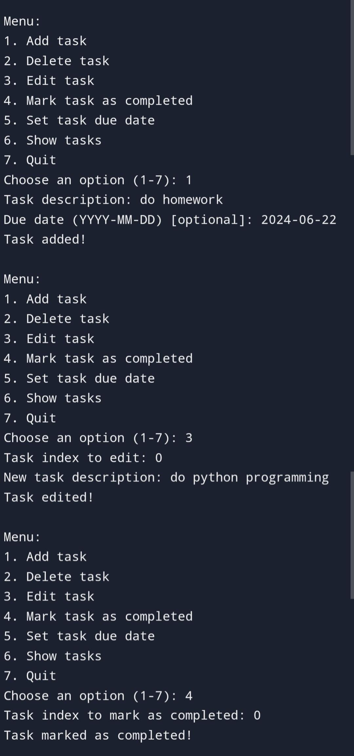
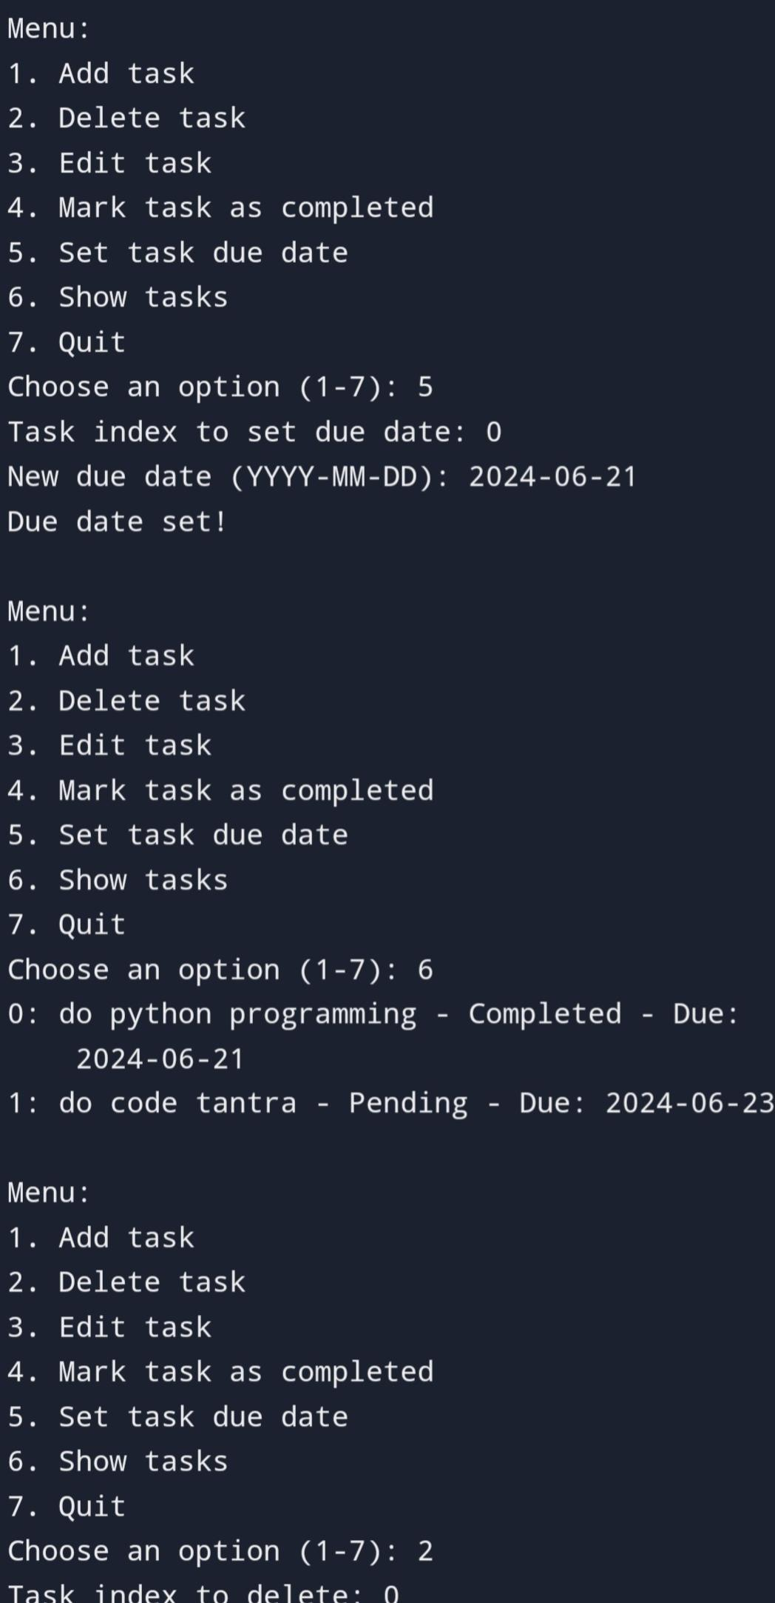
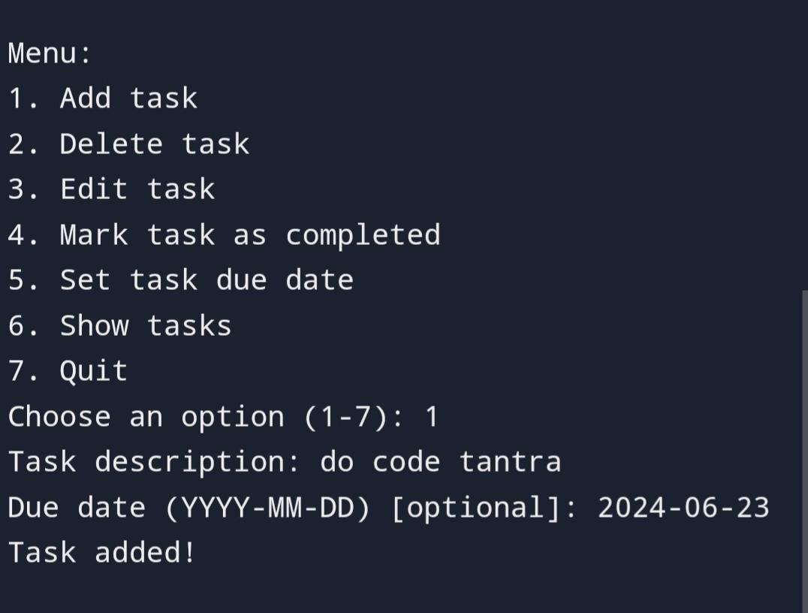
SCREENSHOT

Slide 20
THANK YOU

